Slide 1
2.2: Introduction to generalized linear models
Learning objectives
Understand terminology for mixed-effect models
Understand when random effects are appropriate
Understand basic computational approach to mixed-effect models

Slide 2
How do we estimate things?
Specify a model
Function generating predictions
Identify plausible values for any unknown parameters
Maximize probability of observations given function
Assess uncertainty
Explore function around plausible values

Slide 3
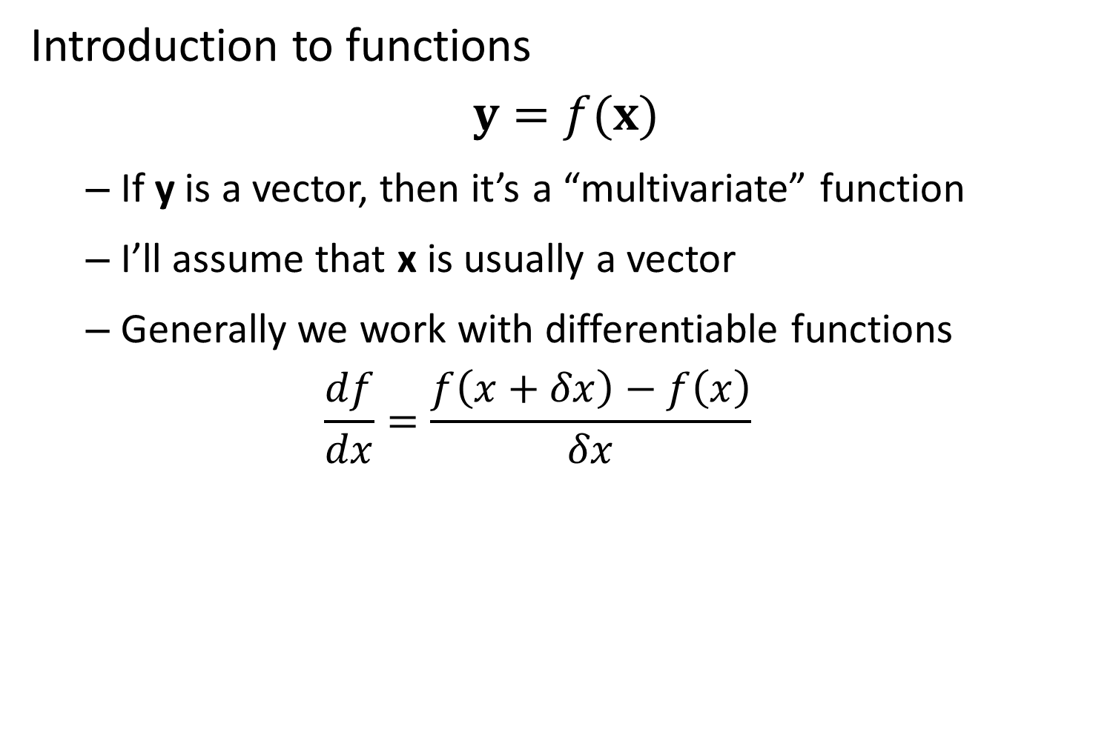
Introduction to functions
$$y=f(x)$$
If y is a vector, then it’s a “multivariate” function
I’ll assume that x is usually a vector
Generally we work with differentiable functions
$$\frac{df}{dx}=\frac{f\left(x+δx\right)−f\left(x\right)}{δx}$$

Slide 4
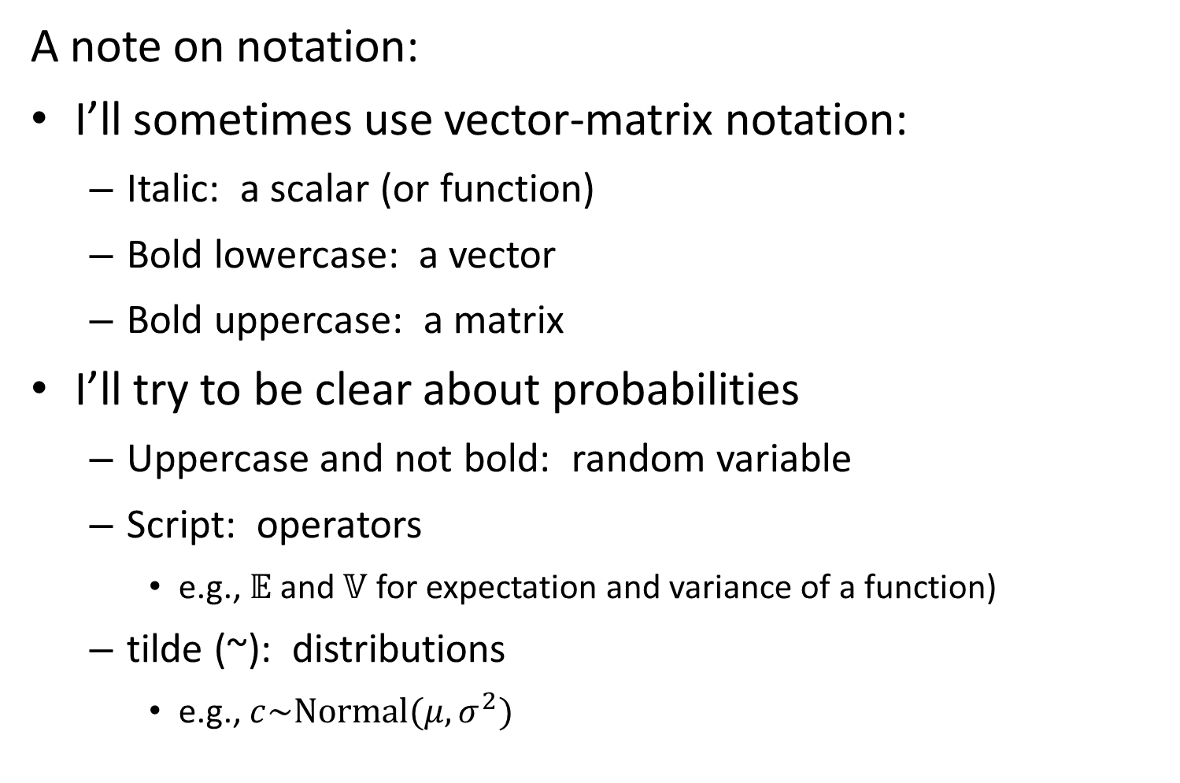
A note on notation:
I’ll sometimes use vector-matrix notation:
Italic: a scalar (or function)
Bold lowercase: a vector
Bold uppercase: a matrix
I’ll try to be clear about probabilities
Uppercase and not bold: random variable
Script: operators
e.g., $𝔼$ and $𝕍$ for expectation and variance of a function)
tilde (~): distributions
e.g., $c\sim Normal(μ,σ^{2})$

Slide 5
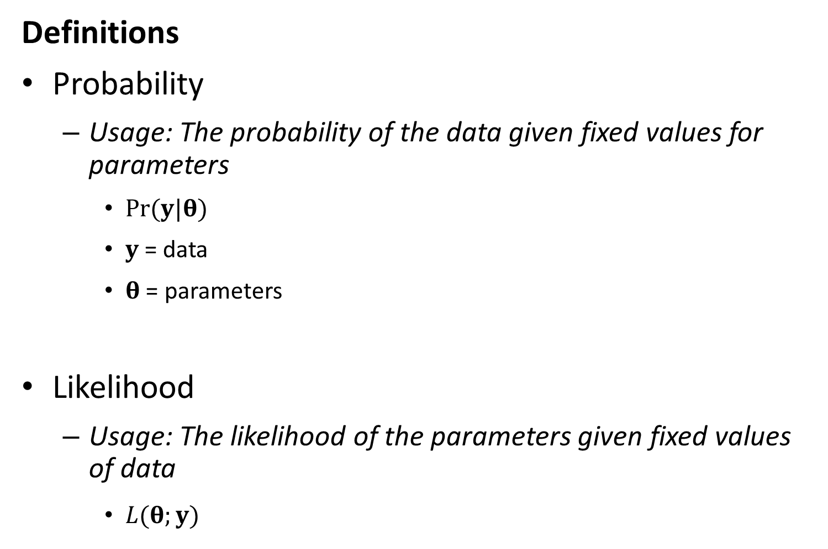
Definitions
Probability
Usage: The probability of the data given fixed values for parameters
$Pr⁡(y|θ)$
$y$= data
$θ$ = parameters
Likelihood
Usage: The likelihood of the parameters given fixed values of data
$L(θ;y)$

Slide 6
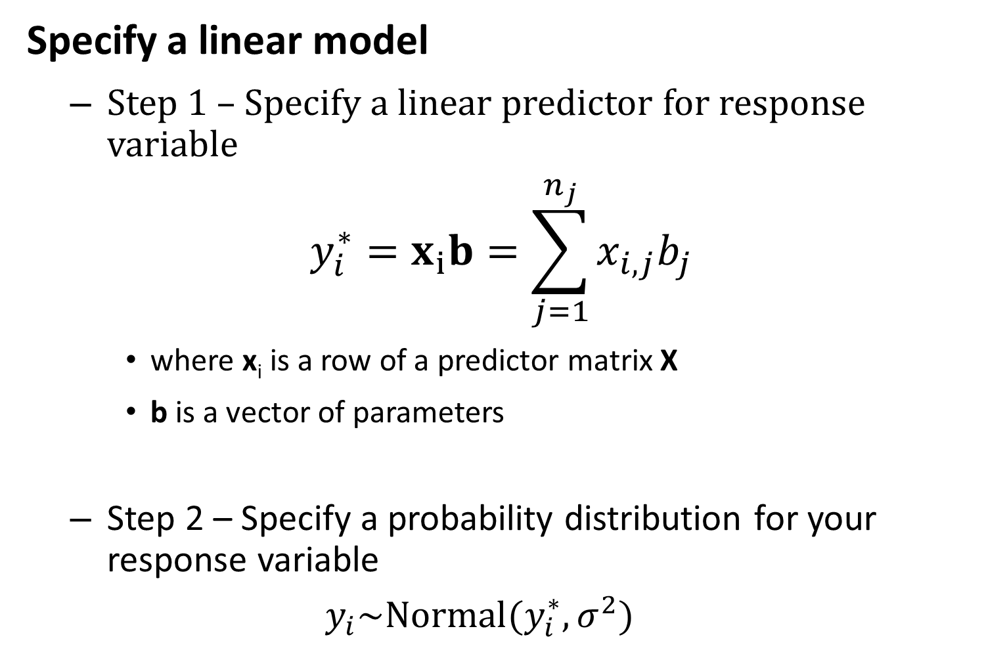
Specify a linear model
Step 1 – Specify a linear predictor for response variable
$$y_{i}^{∗}=x_{i}b=\sum_{j=1}^{n_{j}}{x_{i,j}b_{j}}$$
where x_{i} is a row of a predictor matrix X
b is a vector of parameters
Step 2 – Specify a probability distribution for your response variable
$$y_{i}\sim Normal(y_{i}^{∗},σ^{2})$$

Slide 7
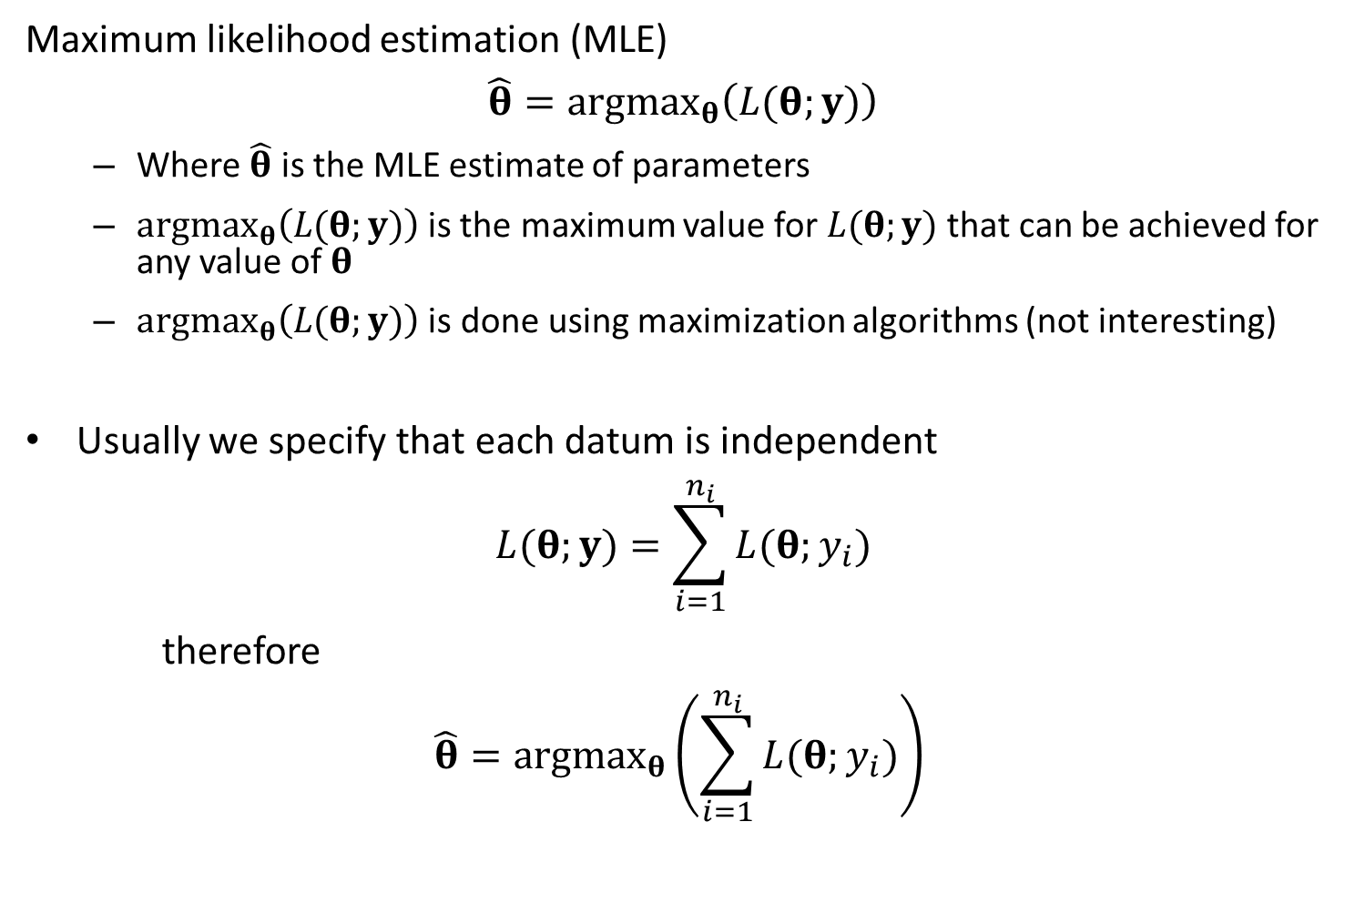
Maximum likelihood estimation (MLE)
$$\hat{θ}=argmax_{θ}\left(L(θ;y)\right)$$
Where $\hat{θ}$ is the MLE estimate of parameters
$argmax_{θ}\left(L(θ;y)\right)$is the maximum value for $L(θ;y)$that can be achieved for any value of $θ$
$argmax_{θ}\left(L(θ;y)\right)$ is done using maximization algorithms (not interesting)
Usually we specify that each datum is independent
$$L(θ;y)=\sum_{i=1}^{n_{i}}{L(θ;y_{i})}$$
therefore
$$\hat{θ}=argmax_{θ}\left(\sum_{i=1}^{n_{i}}{L(θ;y_{i})}\right)$$

Slide 8
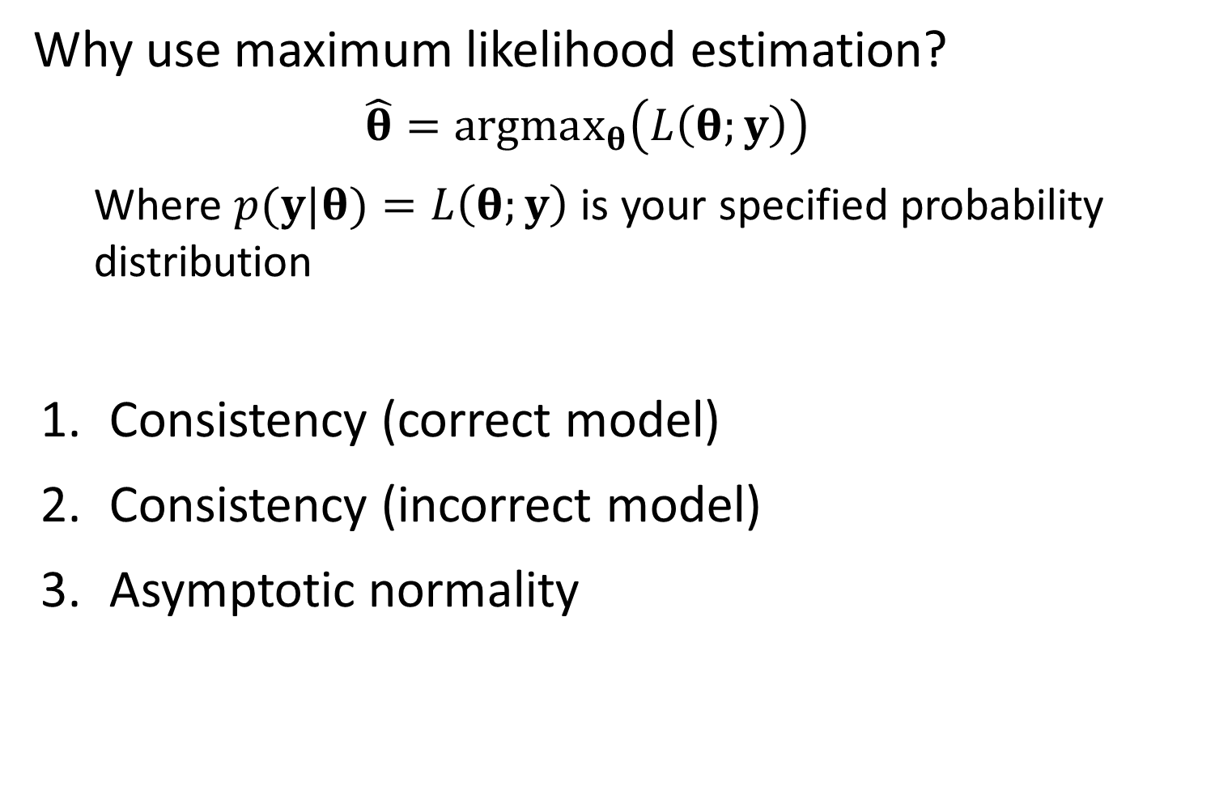
Why use maximum likelihood estimation?
$$\hat{θ}=argmax_{θ}\left(L\left(θ;y\right)\right)$$
Where $p(y|θ)=L\left(θ;y\right)$ is your specified probability distribution
Consistency (correct model)
Consistency (incorrect model)
Asymptotic normality

Slide 9
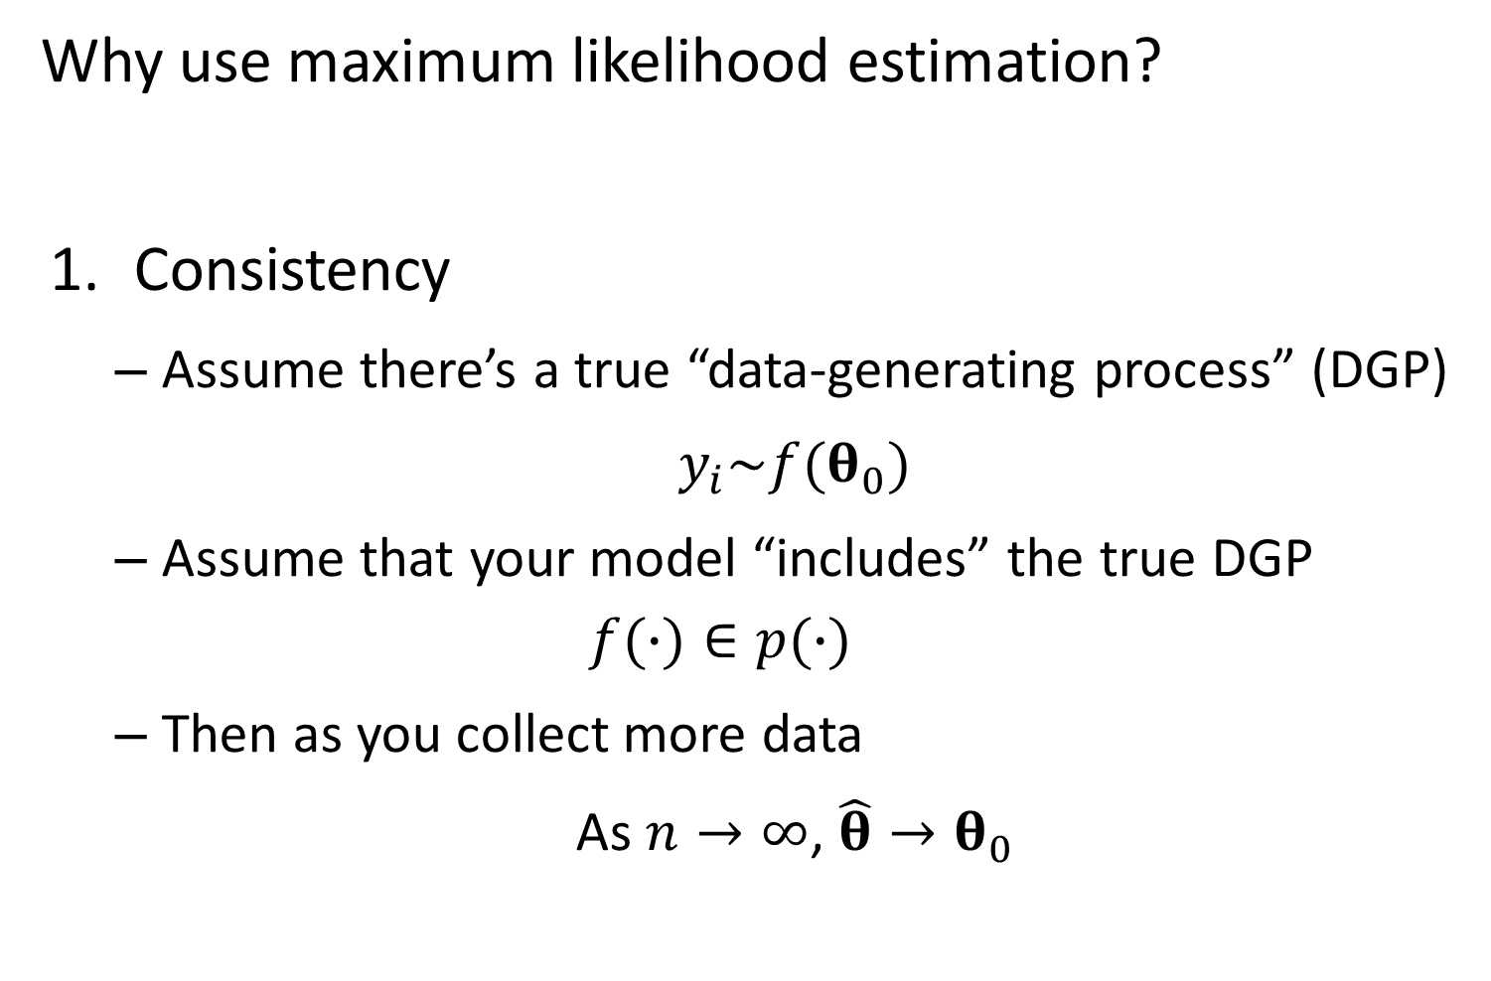
Why use maximum likelihood estimation?
Consistency
Assume there’s a true “data-generating process” (DGP)
$y_{i}\sim f(θ_{0})$
Assume that your model “includes” the true DGP
$$f(∙)∈p(∙)$$
Then as you collect more data
As $n→∞$, $\hat{θ}→θ_{0}$

Slide 10
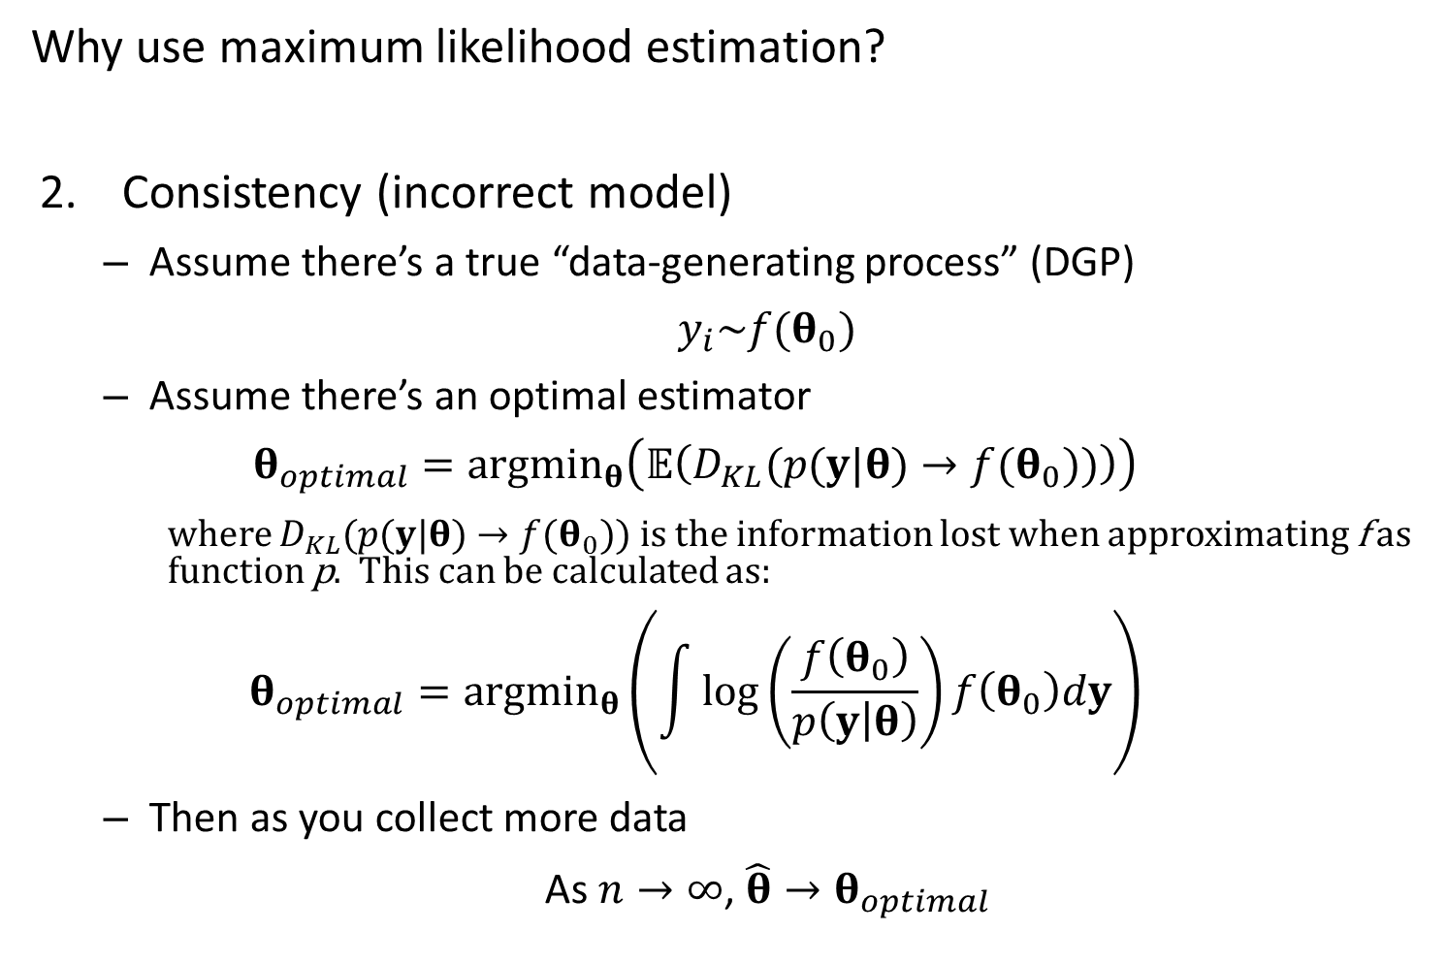
Why use maximum likelihood estimation?
Consistency (incorrect model)
Assume there’s a true “data-generating process” (DGP)
$y_{i}\sim f(θ_{0})$
Assume there’s an optimal estimator
$$θ_{optimal}=argmin_{θ}\left(𝔼\left(D_{KL}(p(y|θ)→f(θ_{0}))\right)\right)$$
where $D_{KL}(p(y|θ)→f(θ_{0}))$ is the information lost when approximating f as function p. This can be calculated as:
$$θ_{optimal}=argmin_{θ}\left(\int{\log\left(\frac{f\left(θ_{0}\right)}{p\left(y | θ\right)}\right)f\left(θ_{0}\right)dy}\right)$$
Then as you collect more data
As $n→∞$, $\hat{θ}→θ_{optimal}$

Slide 11
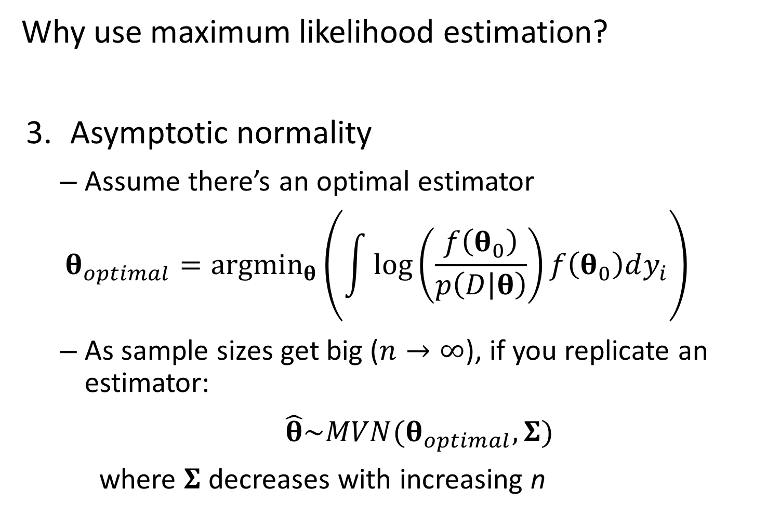
Why use maximum likelihood estimation?
Asymptotic normality
Assume there’s an optimal estimator
$$θ_{optimal}=argmin_{θ}\left(\int{\log\left(\frac{f\left(θ_{0}\right)}{p\left(D | θ\right)}\right)f\left(θ_{0}\right)dy_{i}}\right)$$
As sample sizes get big ($n→∞$), if you replicate an estimator:
$\hat{θ}\sim MVN(θ_{optimal},Σ)$
where $Σ$ decreases with increasing n

Slide 12
Implications
If you have a simulation design…
… and the model used to simulate data is identical to the model used to estimate parameters
Estimated parameters will be perfect with large sample sizes
Total error will go to zero with large sample sizes
… and your estimation model doesn’t match the simulation model
Estimated parameters will converge on values with large sample sizes
Total error will decrease to an asymptote

Slide 13
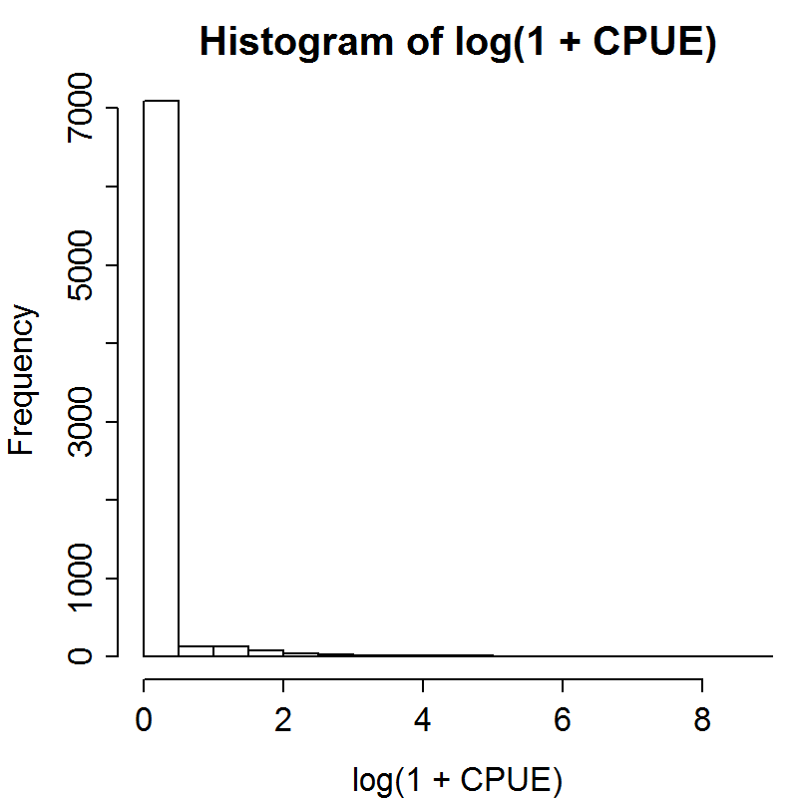
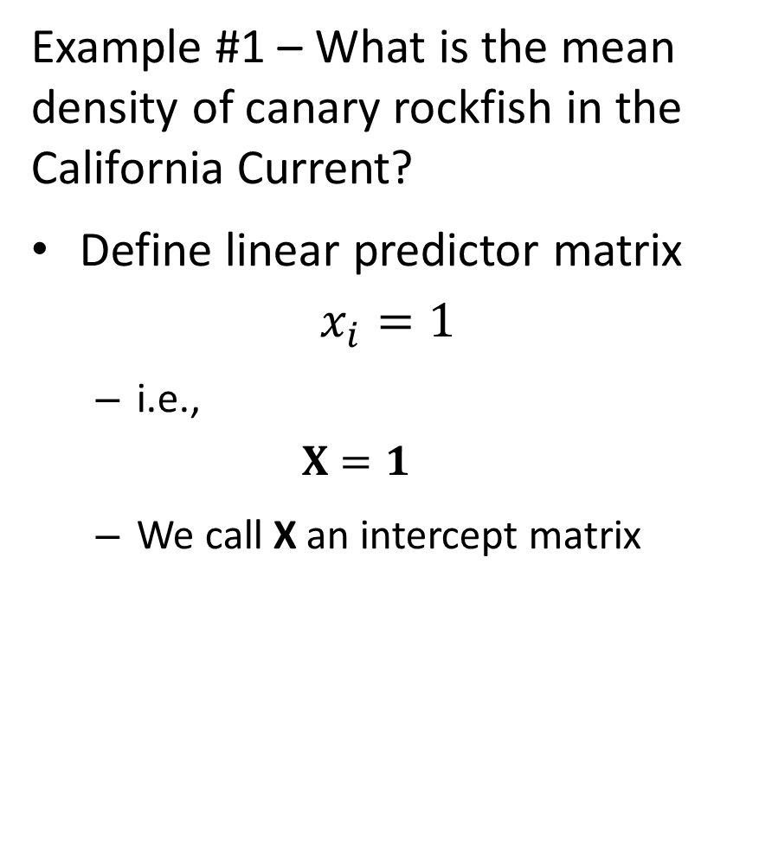
Example #1 – What is the mean density of canary rockfish in the California Current?
Define linear predictor matrix
$$x_{i}=1$$
i.e.,
$$X=1$$
We call X an intercept matrix

Slide 14
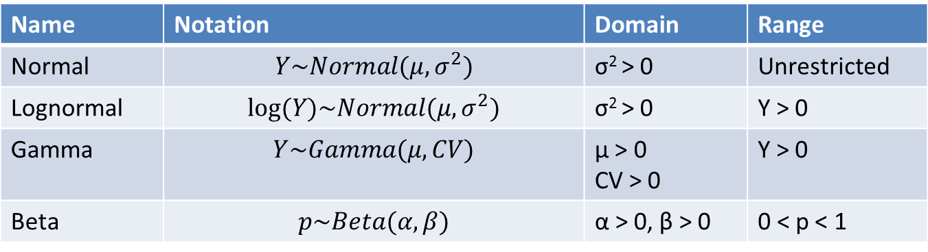
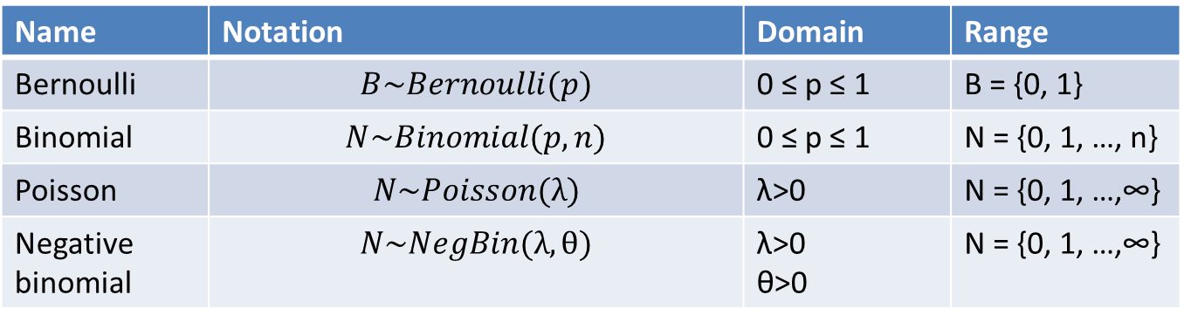
Common distributions for data
Discrete
Continuous
Name | Notation | Domain | Range
Bernoulli | $$B\sim Bernoulli(p)$$ | 0 ≤ p ≤ 1 | B = {0, 1}
Binomial | $$N\sim Binomial(p,n)$$ | 0 ≤ p ≤ 1 | N = {0, 1, …, n}
Poisson | $$N\sim Poisson(λ)$$ | λ>0 | N = {0, 1, …,∞}
Negative binomial | $$N\sim NegBin(λ,θ)$$ | λ>0 θ>0 | N = {0, 1, …,∞}
Name | Notation | Domain | Range
Normal | $$Y\sim Normal(μ,σ^{2})$$ | σ² > 0 | Unrestricted
Lognormal | $$log⁡(Y)\sim Normal(μ,σ^{2})$$ | σ² > 0 | Y > 0
Gamma | $$Y\sim Gamma(μ,CV)$$ | μ > 0 CV > 0 | Y > 0
Beta | $$p\sim Beta(α,β)$$ | α > 0, β > 0 | 0 < p < 1

Slide 15
How to chose a distribution for data?
Choice 1 – is it continuous or discrete?
Continuous: normal, lognormal, beta, gamma
Discrete: Bernoulli, binomial, poisson, negative binomial
Choice 2 – what is the range of possible values?
E.g., if discrete:
If it is 0 or 1, then its Bernoulli
If its between 0 and N, where N is the number of trials, then its Binomial
Choice 3 – How flexible do you want it?

Slide 16
How to chose a distribution for data?
Frequent null models:
Binomial
Poisson
Normal

Slide 17
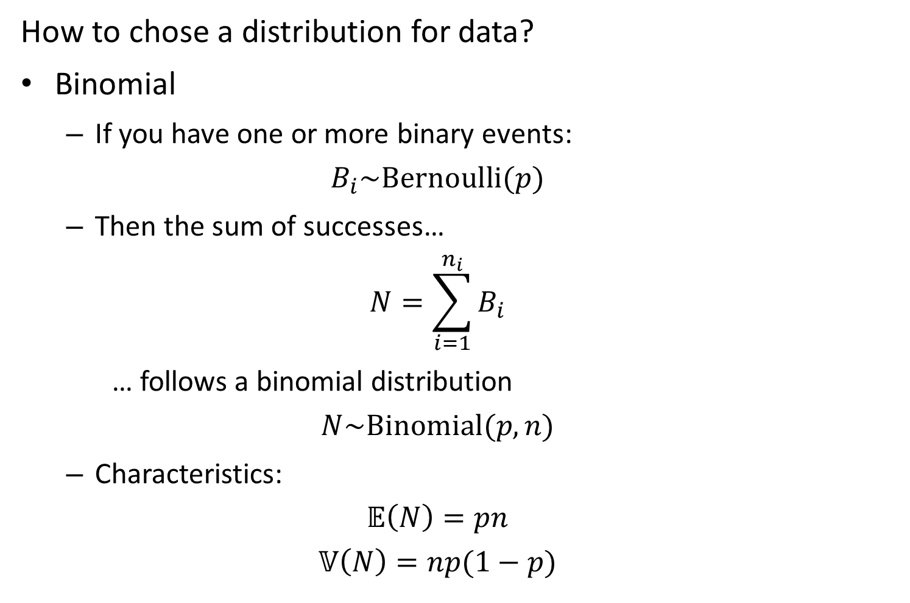
How to chose a distribution for data?
Binomial
If you have one or more binary events:
$$B_{i}\sim Bernoulli(p)$$
Then the sum of successes…
$$N=\sum_{i=1}^{n_{i}}{B_{i}}$$
… follows a binomial distribution
$$N\sim Binomial(p,n)$$
Characteristics:
$$𝔼\left(N\right)=pn$$
$$𝕍\left(N\right)=np(1−p)$$

Slide 18
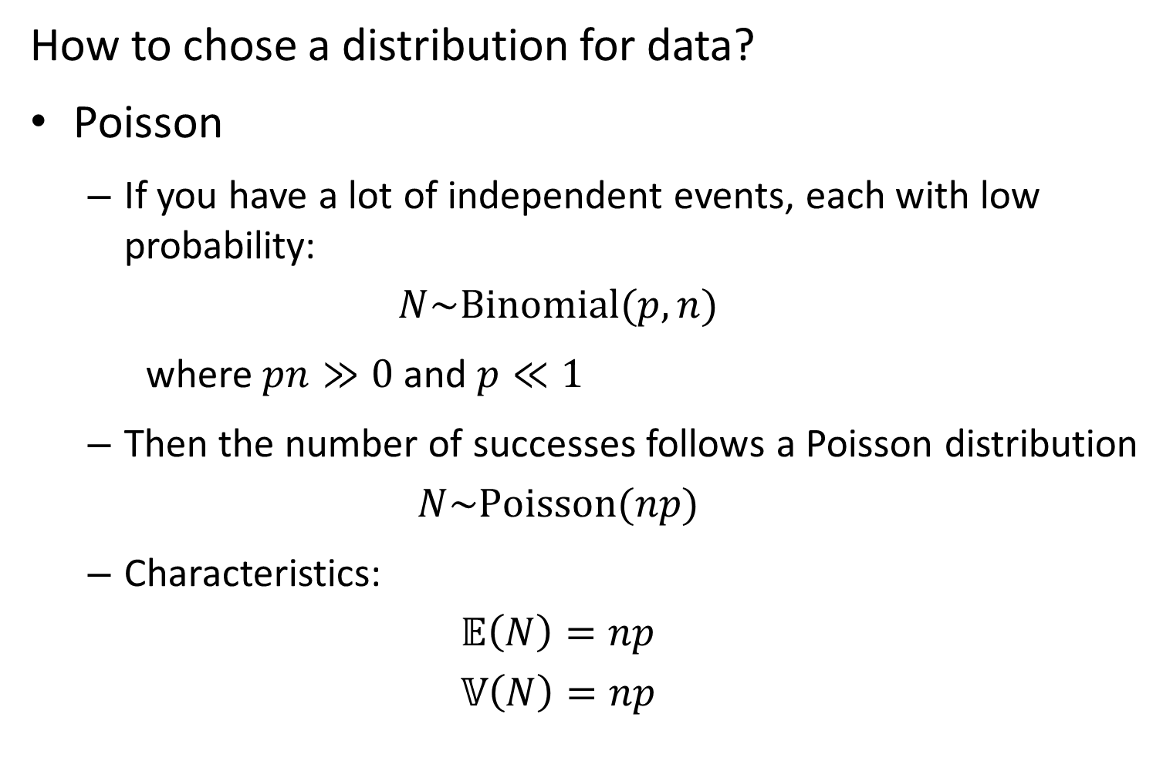
How to chose a distribution for data?
Poisson
If you have a lot of independent events, each with low probability:
$$N\sim Binomial(p,n)$$
where $pn≫0$ and $p≪1$
Then the number of successes follows a Poisson distribution
$$N\sim Poisson(np)$$
Characteristics:
$$𝔼\left(N\right)=np$$
$$𝕍\left(N\right)=np$$

Slide 19
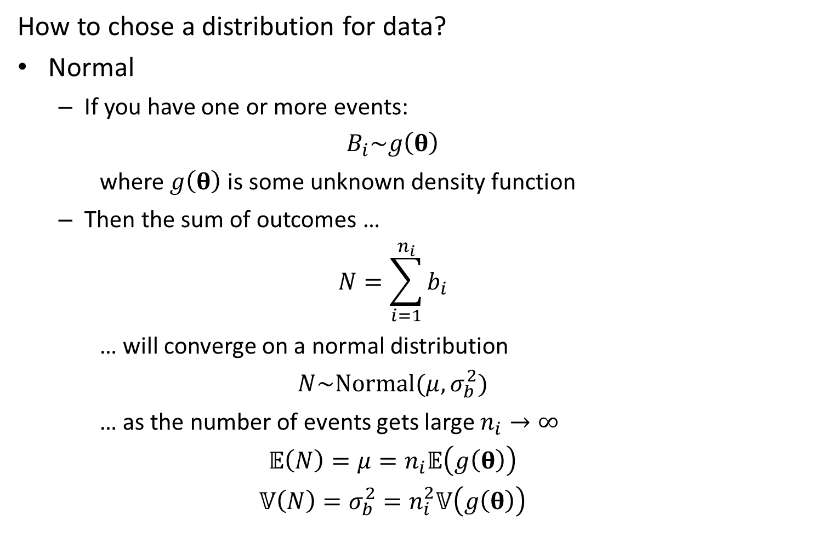
How to chose a distribution for data?
Normal
If you have one or more events:
$$B_{i}\sim g\left(θ\right)$$
where $g\left(θ\right)$ is some unknown density function
Then the sum of outcomes …
$$N=\sum_{i=1}^{n_{i}}{b_{i}}$$
… will converge on a normal distribution
$$N\sim Normal(μ,σ_{b}^{2})$$
… as the number of events gets large $n_{i}→∞$
$$𝔼\left(N\right)=μ=n_{i}𝔼\left(g\left(θ\right)\right)$$
$$𝕍\left(N\right)=σ_{b}^{2}=n_{i}^{2}𝕍\left(g\left(θ\right)\right)$$

Slide 20
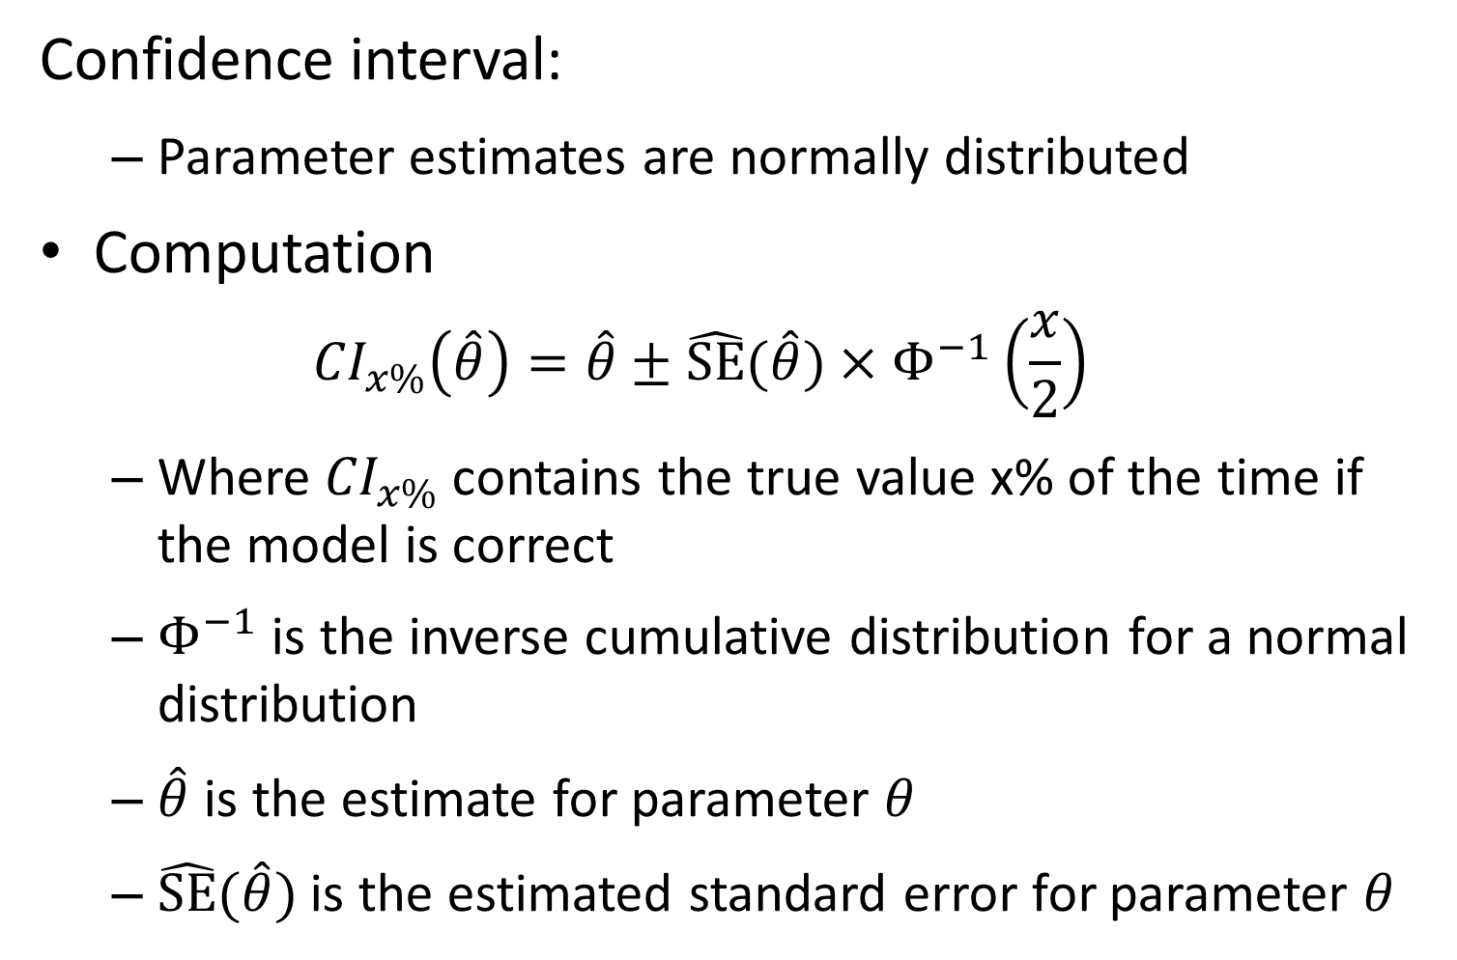
Confidence interval:
Parameter estimates are normally distributed
Computation
$${CI}_{x\%}\left(\hat{θ}\right)=\hat{θ}±\hat{SE}(\hat{θ})×Φ^{−1}\left(\frac{x}{2}\right)$$
Where ${CI}_{x\%}$ contains the true value x% of the time if the model is correct
$Φ^{−1}$ is the inverse cumulative distribution for a normal distribution
$\hat{θ}$ is the estimate for parameter $θ$
$\hat{SE}(\hat{θ})$ is the estimated standard error for parameter $θ$

Slide 21
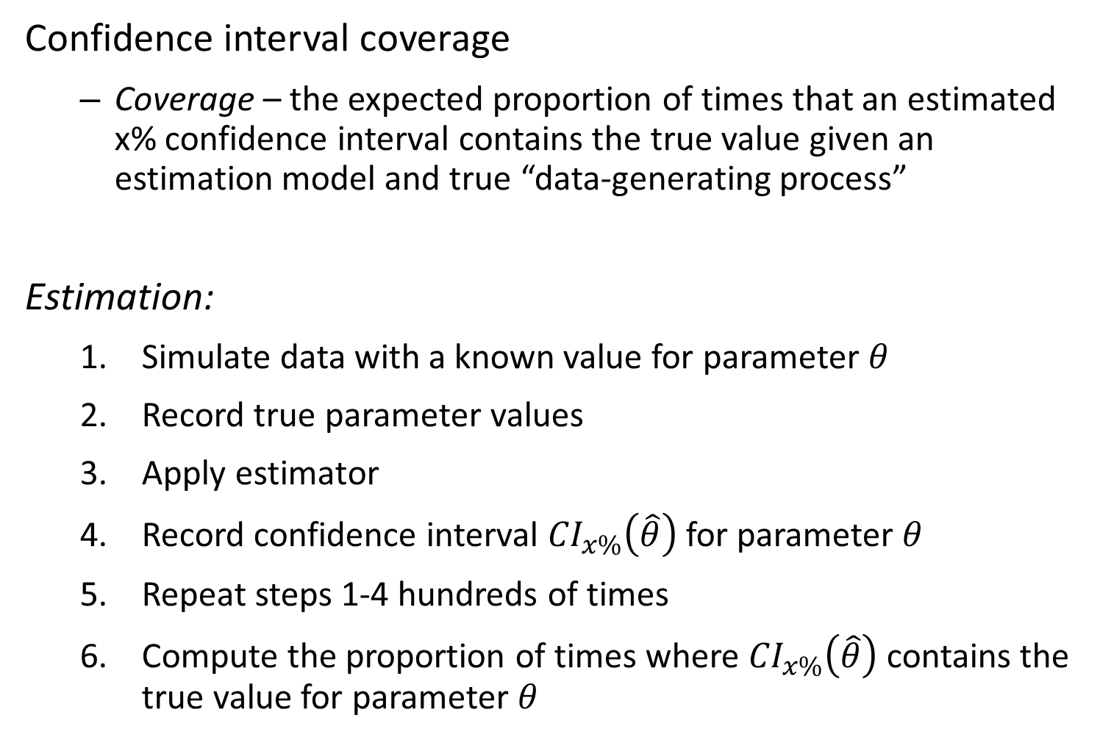
Confidence interval coverage
Coverage – the expected proportion of times that an estimated x% confidence interval contains the true value given an estimation model and true “data-generating process”
Estimation:
Simulate data with a known value for parameter $θ$
Record true parameter values
Apply estimator
Record confidence interval ${CI}_{x\%}\left(\hat{θ}\right)$ for parameter $θ$
Repeat steps 1-4 hundreds of times
Compute the proportion of times where ${CI}_{x\%}\left(\hat{θ}\right)$ contains the true value for parameter $θ$

